Slide 1
1
Introduction
2
Related Work
3
Method
INDEX
4
Experiment
5
Results
6
Conclusion
7
Reference

Slide 2
1. Introduction
Thank you

Slide 3
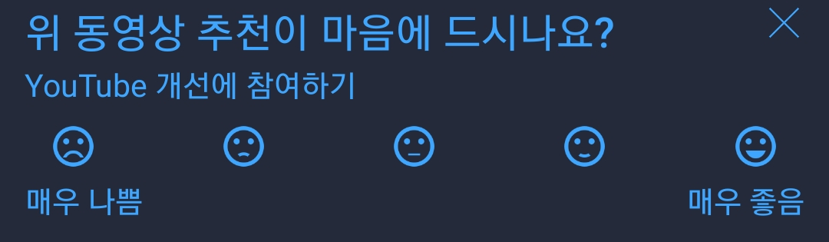
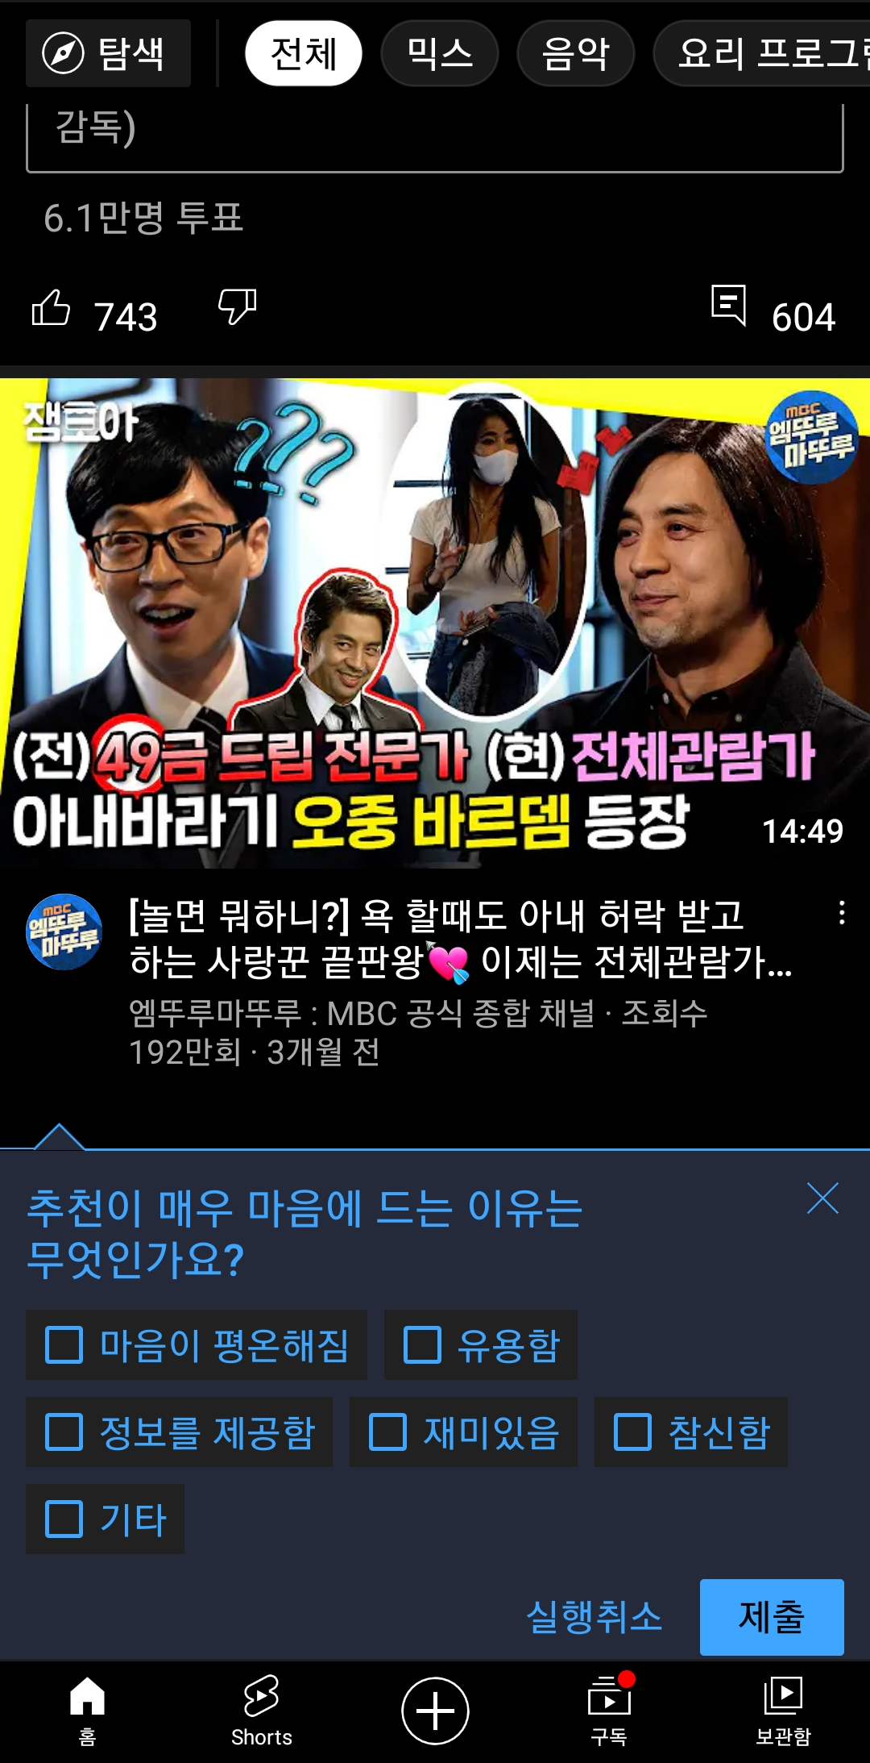
Figure 1: YouTube report related to CX

Slide 4
2. Related Work
Thank you

Slide 5
2. Background
Definition
Sentiment divides user’s positive and negative feelings into 5-levels (ordinal)
Emotion divides user’s psychological feelings into 6-levels. (categorical)
0 | 1 | 2 | 3 | 4
Negative | Somewhat Negative | Neutral | Somewhat Positive | Positive
0 | 1 | 2 | 3 | 4 | 5
anger | fear | joy | love | sadness | surprise

Slide 6
3. Method
Thank you

Slide 7
3. Method
(Step 1)
Web Crawling
Movie Database
(Step 2)
Sampling
(Step 4)
Review
Rating
Review
BERT
BERT
(Step 3)
Normalization
Sentiment / Emotion
Sentiment
Emotion
(Step 4)
Multi-relations graph
generating
(Step 5)
GCMC
(Step 6)
Rating Prediction

Slide 8
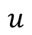
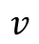
3. Framework1 – Before Encoding
rating
3
sentiment
emotion
$$u$$
12
$$v$$
17
Figure 1: multi-relations based graph
Figure 1: Adjacency-matrix~~(동희)
Notes:
그래프를 단순 합으로 결합
Multi-layer로 구성하여 GNN 학습

Slide 9

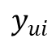
3. Framework1 – Before Encoding
U | R | M
0 | 3.5 | 0
1 | 4.5 | 1
2 | 1.0 | 2
Target
$$y_{ui}$$
(Rating)
U | R | M
0 | 3 | 0
1 | 2 | 1
2 | 1 | 2
User embedding
GCMC
Encoder
GCMC
Decoder
$${\hat{y}}_{ui}$$
Prediction
Item embedding
(Sentiment)
U | R | M
0 | 5 | 0
1 | 2 | 1
2 | 3 | 2
(Emotion)
Figure 2: multi-relations based GCMC framework
Notes:
그래프를 단순 합으로 결합
Multi-layer로 구성하여 GNN 학습

Slide 10
4. Experiment
Thank you

Slide 11
4. Experiment – dataset (Movie)
Dataset
Period : 1914.06.01 ~ 2020.10.31
Link : https://www.kaggle.com/stefanoleone992/rotten-tomatoes-movies-and-critic-reviews-dataset
Data
File name | Dimension | Columns
Movie data | (17713, 22) | 'rotten_tomatoes_link', 'movie_title', 'movie_info', 'critics_consensus', 'content_rating', 'genres', 'directors', 'authors', 'actors', 'original_release_date', 'streaming_release_date', 'runtime', 'production_company', 'tomatometer_status', 'tomatometer_rating', 'tomatometer_count', 'audience_status', 'audience_rating', 'audience_count', 'tomatometer_top_critics_count', 'tomatometer_fresh_critics_count', 'tomatometer_rotten_critics_count'
Review data | (1048576, 8) | rotten_tomatoes_link, critic_name, top_critic, publisher_name, review_type, review_score, review_date, review_content
Rating | Review | Amount | Rate
O | O | 758,709 | 67%
X | O | 305,502 | 27%
O | X | 65,372 | 5%
X | X | 434 | 0.03%

Slide 12
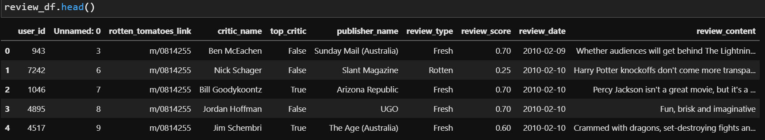
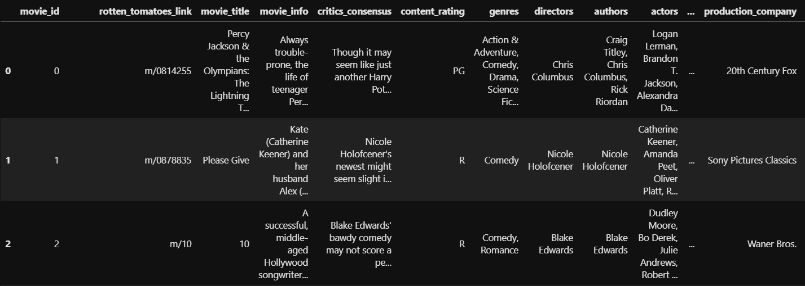
4. Experiment – dataset (Movie)
Dataset
Rating matrix
Group : critic_name, top_critic, publisher_name
The number of users : 9,794
Movie matrix
The number of movies: 17,614

Slide 13
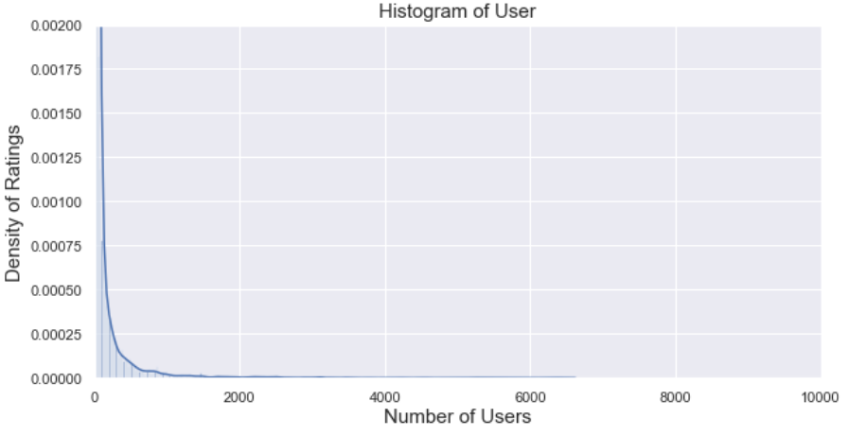
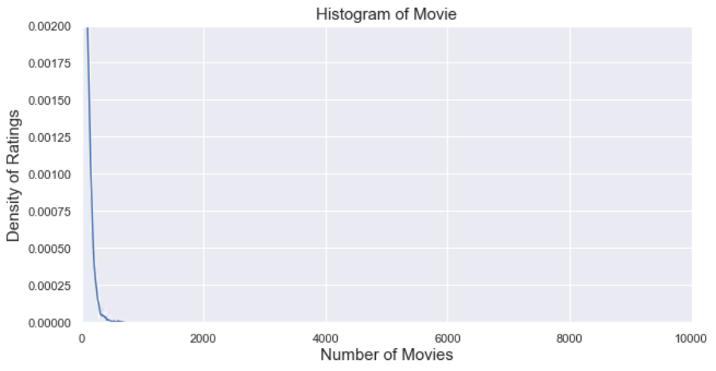
4. Experiment – dataset (Movie)
Histogram
Group: User, Movie
Train/test rate = 9 : 1 (by timestamp)
Number: user_id(850), movie_id(6,805)
Exclude cold-start problem (user, item)
Range | User | Movie
Total | 9,794 | 17,614
< 3 | 3,552 (36%) | 993 (6%)
< 5 | 4,653 (48%) | 2,892 (16%)
>= 20 | 2,994 (31%) | 8,110 (46%)
>= 500 | 345 (4%) | 13 (0%)
Reviews >= 20
<User>
<Movie>

Slide 14
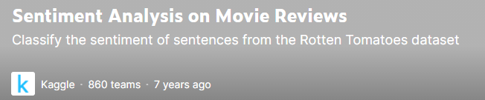
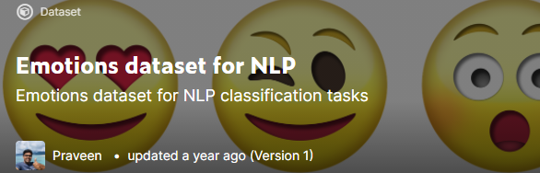
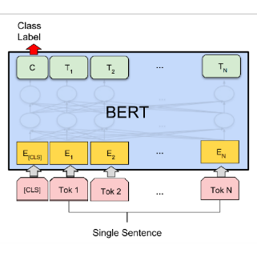
4. Experiment – dataset (sentiment, emotion)
Sentiment, Emotion dataset
Training data for BERT model in Kaggle
Sentiment
Emotion
Feature generating/augmentation using BERT fine-tuning
0 | 1 | 2 | 3 | 4
Negative | Somewhat Negative | Neutral | Somewhat Positive | Positive
0 | 1 | 2 | 3 | 4 | 5
anger | fear | joy | love | sadness | surprise
Review data
Result
U | E | M
0 | 1 | 1
1 | 3 | 1
2 | 2 | 2
Uma Thurman as Medusa, the gorgon with a coiffure of writhing snakes and stone-inducing hypnotic gaze is one of the highlights of this bewitching fantasy
Sentiment, emotion value
(graph)

Slide 15
4. Experiment – Table
Result
Graph type : Rating, Sentiment, Emotion + Meta informaion
Data : 60% (rating, review)
Ideal result
Type | Method | RMSE/MAE | Data
Baselines | CF MF: SVD, SVD++ | Low | Rating
Graph (in general) | GCMC | Middle | Rating
Graph (our model) | GCMC + “novelty” | High | Rating
 |  |  | Rating + Sentiment
 |  |  | Rating + Emotion
 |  |  | Rating + Sentiment + Emotion

Slide 16
5. Results
Thank you

Slide 17
5. Results – Table
16 Experiments
Algorithm | RMSE | RANK
SVD | 0.8469 | 6
SVDpp | 0.8270 | 5
SlopeOne | 0.9273 | 14
NMF | 0.9056 | 10
NormalPredictor | 1.4758 | 17
KNNBasic | 0.8726 | 9
KNNBaseline | 0.8519 | 8
KNNWithMeans | 0.9232 | 13
KNNWithZScore | 0.9168 | 12
BaselineOnly | 0.8485 | 7
CoClustering | 0.9538 | 15
GCMC(Feature X) - regression | 0.9637 | 16
GCMC(Feature O) - regression | 0.9148 | 11
GCMC(Feature X) | 0.8142 | 4
GCMC(Feature O) | 0.7176 | 3
GCMC(Feature O, T=0.8) | 0.7127 | 2
GCMC(Feature O, framework1) | 0.7091 | 1
Surprise
GCMC

Slide 18
5. Results – RMSE Graph

Slide 19
5. Results – RMSE Graph
Box plot (천솔)

Slide 20
6. Conclusion
Thank you

Slide 21
7. Reference
Thank you

Slide 22
2. Related Work (cont’d)
Emotion Analysis
[1] The impact of emotions on the helpfulness of movie reviews (JART 2015)
[2] Tensor-based tag emotion aware recommendation with probabilistic ranking. (KSII 2019)
[3] Item recommendation using tag emotion in social cataloging services. (ScienceDirect 2017)
[4] Using Affective Features from Media Content Metadata for Better Movie Recommendations (KDIR 2020)
Detect movie overviews’ implicit affective features like emotion and sentiment.
Strength: reflect dynamic information like user’s emotion and sentiment
Sentiment Analysis
[5] Review Sentiment-Guided Scalable Deep Recommender System (SIGIR 2018)
[6] How to improve the accuracy of recommendation systems: Combining ratings and review texts sentiment scores. (JIIS 2019)
[7] The impact of emotions on the helpfulness of movie reviews (JART 2015)
There is a correlation between emotions about the movie reviews and satisfaction.
[8] Integrating Collaborative Filtering and Sentiment Analysis : A Rating Inference Approach (ECAI workshop 2006)
Approach sentiment analysis with statistical techniques
[9] BERT 기반 감성분석을 이용한 추천시스템 (KCI 2021)
Comparing Emotional Analysis with ML/DL Techniques and Presenting the Performance of BERT
Limitation : rating inference was only carried out, and explainable recommendation is not possible.
[10] Movie Recommendation System Using Sentiment Analysis From Microblogging Data (IEEE transactions on computational social systems 2020)
Hybrid RS from collaborative filtering(CF) and content-based filtering(CBF) along with sentiment analysis

Slide 23
2. Related Work
Graph Neural Network
[11] Semi-Supervised Classification with Graph Convolutional Networks (ICLR 2017)
GCMC-based
[12] Graph Convolutional Matrix Completion (KDD 2018)
[13] Inductive Matrix Completion based on Graph Neural Networks (ICLR 2020)
[14] Inductive Matrix Completion Using Graph Autoencoder (CIKM 2021)
[15] AIRC: Attentive Implicit Relation Recommendation Incorporating Content Information for Bipartite Graphs (MDPI 2020)
Multi-layer graphs
[16] Community Detection in Multi-Layer Graphs: A Survey (SIGMOD 2015)
Link-prediction and GCN
[17] Link Prediction Based on Graph Neural Networks (NIPS 2018)
[18] Web Service Network Embedding based on Link Prediction and Convolutional Learning (IEEE Transactions on Services Computing)
Bi-partite graph
[19] Bipartite graph partitioning and data clustering (CIKM 2001)
[20] Metadata-Based Collaborative Filtering Using K-Partite Graph for Movie Recommendation (EDB 2012)
[21] Domain Knowledge-Based Link Prediction in Customer-Product Bipartite Graph for Product Recommendation (IJIT & DM 2019)

